Slide 1


Some of Scott Meyers’s wisdom
Andrei Toader

Slide 2
Different meanings of new and delete
- “new operator”
Notes:
Operator built in the language.
Its meaning can’t be changed.
What it does is two fold:
First it allocates enough memory to withhold an object of the type requested (in this case sizeof(std::string))
It calls the appropriate constructor to initialize the object in memory.

Slide 3
Different meanings of new and delete
- “operator new”
Notes:
The “operator new” is called by the “new operator” to perform the memory allocation.
This function can be overloaded by us to change its behavior.
This function returns raw, uninitialized memory (void*).

Slide 4

Different meanings of new and delete
- “operator new”
Notes:
You’ll probably never want to call “operator new”, but if you want it, this is how you can do it.
Like mentioned before, its sole responsibility is to allocate memory.
It knows nothing about constructors.

Slide 5

Different meanings of new and delete
When compilers see a statement like this:
They more or less generate code that looks like this:
Notes:
You’ll probably never want to call “operator new”, but if you want it, this is how you can do it.
Like mentioned before, its sole responsibility is to allocate memory.
It knows nothing about constructors.

Slide 6
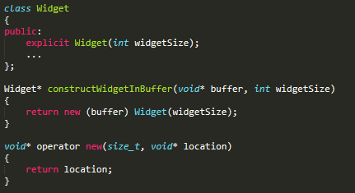
Different meanings of new and delete
- “Placement new”
Notes:
Invoking a constructor on an existing object makes no sense, because constructors initialize objects, and an object can only be initialized once, at its first value, once.
It is a special version of “operator new” called placement new.
It is used when you have some raw memory allocated and you want to construct the object in that memory.
The purpose of operator new is to find memory for an object and return a pointer to that memory.
In the case of placement new, the caller already knows what the pointer to the memory should be.
All placement new has to do then, is return the pointer that’s passed into it.
To use placement new, you need to include <new>.

Slide 7

Different meanings of new and delete
- “operator delete”
Notes:
To avoid resource leaks, every dynamic allocation must be matched by an equal and opposite deallocation.

Slide 8


Different meanings of new and delete
- When you write something like this:
- Compilers will generate something like this:
Notes:
To avoid resource leaks, every dynamic allocation must be matched by an equal and opposite deallocation.
The function operator delete is to the built-in delete operator as operator new is to the new operator.

Slide 9

Different meanings of new and delete
- If you want to deal only with raw, uninitialized memory, you should bypass the new and delete operators entirely.
Notes:
This is the C++ equivalent of malloc and free.

Slide 10
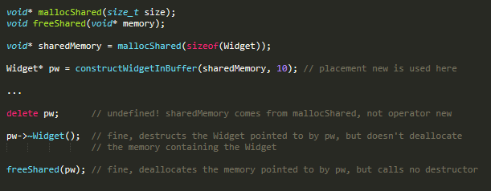
Different meanings of new and delete
- Also, if you used placement new, don’t use delete operator.
Notes:
This is the C++ equivalent of malloc and free.

Slide 11

Different meanings of new and delete
- Equivalent for arrays: “operator new[]” and “operator delete[]”
- Always make sure to use the corresponding operators!!!
Notes:
This is the C++ equivalent of malloc and free.

Slide 12
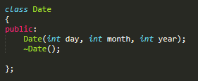
Make interfaces easy to use correctly
And hard to use incorrectly
- Always consider the mistakes clients might make.
Notes:
Assuming you’re dealing with reasonable people, the clients are trying to do a job.
Ideally, if an attempted use of an interface won’t do what the client expects, the code won’t compile, and if the code compiles, it will do what the client wants.
At first glance, this interface might seem reasonable, at least in Europe (USA would beg to differ).

Slide 13

Make interfaces easy to use correctly
And hard to use incorrectly
- -> a possible correct use
- -> USA might agree with this
- -> 4 is next to 5 so… typo!
Notes:
Assuming you’re dealing with reasonable people, the clients are trying to do a job.
Ideally, if an attempted use of an interface won’t do what the client expects, the code won’t compile, and if the code compiles, it will do what the client wants.
At first glance, this interface might seem reasonable, at least in Europe (USA would beg to differ).

Slide 14



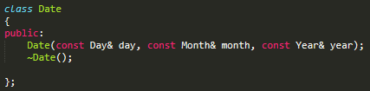

Make interfaces easy to use correctly
And hard to use incorrectly
- Something a bit better:
Notes:
Assuming you’re dealing with reasonable people, the clients are trying to do a job.
Ideally, if an attempted use of an interface won’t do what the client expects, the code won’t compile, and if the code compiles, it will do what the client wants.
At first glance, this interface might seem reasonable, at least in Europe (USA would beg to differ).
Introducing new types can work wonders for the prevention of interface usage errors.
Full-fledged classes with encapsulated data would be even better than the use of structs above.

Slide 15
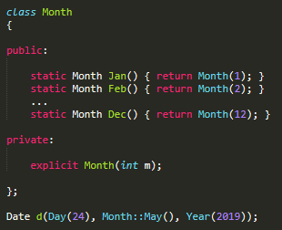
Make interfaces easy to use correctly
And hard to use incorrectly
- Once the right types are in place, you might even want to restrict the values of those types…
Notes:
A possible solution until C++11 would have been this one:

Slide 16
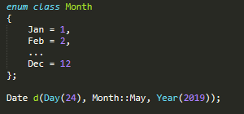
Make interfaces easy to use correctly
And hard to use incorrectly
- An even better solution after C++11, Scott would agree to be the use of enum classes…
Notes:
The reason classes were preferred over enumerations until C++11 is because they were not type-safe and may have caused name crashes over namespaces.

Slide 17
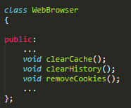
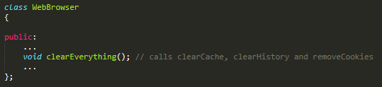
Prefer non-member non-friend functions to member functions
- Many users would want to do this altogether, so the class might offer a function to just to that…
Notes:
Imagine a class for representing web browsers.
This class might offer some options to clear the cache, history and remove all the cookies from the system.

Slide 18

Prefer non-member non-friend functions to member functions
- Of course, this functionality could also be provided by a non-member function that calls the appropriate member functions:
- So… which is better?
Notes:
Object-oriented principles dictate that data and the functions that
operate on them should be bundled together, and that suggests that
the member function is the better choice. Unfortunately, this suggestion
is incorrect.
It’s based on a misunderstanding of what being
object-oriented means. Object-oriented principles dictate that data
should be as encapsulated as possible.
Counterintuitively, the member
function clearEverything actually yields less encapsulation than the
non-member clearBrowser.

Slide 19
Prefer non-member non-friend functions to member functions
- Scott’s explanation:
- “The more functions that can access it, the less encapsulated the data.”
- Reason: Given a choice between a member function(which can access not only the private data of a class, but also private functions, enums, etc…) and a non-member non-friend function (which can access none of these things) providing the same functionality, the choice which yields greater encapsulation is the non-member non-friend function. It does not increase the number of functions that can access the private parts of the class.
Notes:
We’ll begin with encapsulation. If something is encapsulated, it’s hidden
from view. The more something is encapsulated, the fewer things
can see it. The fewer things can see it, the greater flexibility we have to
change it, because our changes directly affect only those things that
can see what we change. The greater something is encapsulated, then,
the greater our ability to change it. That’s the reason we value encapsulation
in the first place: it affords us the flexibility to change things
in a way that affects only a limited number of clients.
Consider the data associated with an object. The less code that can
see the data (i.e., access it), the more the data is encapsulated, and
the more freely we can change characteristics of an object’s data, such
as the number of data members, their types, etc. As a coarse-grained
measure of how much code can see a piece of data, we can count the
number of functions that can access that data: the more functions
that can access it, the less encapsulated the data.

Slide 20

Prefer non-member non-friend functions to member functions
- Just because concerns about encapsulation dictate that a function be a non-member of one class, doesn’t mean it can’t be a member of another class.
- In C++, a more natural approach is to make clearBrowser a non-member function in the same namespace as WebBroswer.
Notes:
This has more going for it than naturalness, however, because
namespaces, unlike classes, can be spread across multiple source
files. That’s important, because functions like clearBrowser are convenience
functions. Being neither members nor friends, they have no
special access to WebBrowser, so they can’t offer any functionality a
WebBrowser client couldn’t already get in some other way. For example,
if clearBrowser didn’t exist, clients could just call clearCache, clear-
History, and removeCookies themselves.
A class like WebBrowser might have a large number of convenience
functions, some related to bookmarks, others related to printing, still
others related to cookie management, etc.

Slide 21
THANK YOU

